Slide 1


Team 18: Kubernetes
Based Attacks
Bi-Weekly Update 2 Thomas Gumienny, Patrick Churchill, Albert Ma Sponsor: Sandip Roy TA: Sabyasachi Gupta
Notes:
Michelle

Slide 2
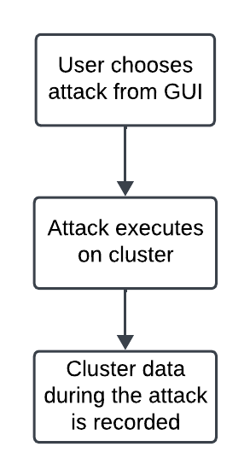
Project Summary
The US Navy is using Kubernetes to manage software. However, as a relatively new cyberservice, Kubernetes has a variety of cybersecurity weaknesses.
Develop a Kubernetes testbed that can simulate and collect the data of common types of attacks.
Notes:
Kyle

Slide 3
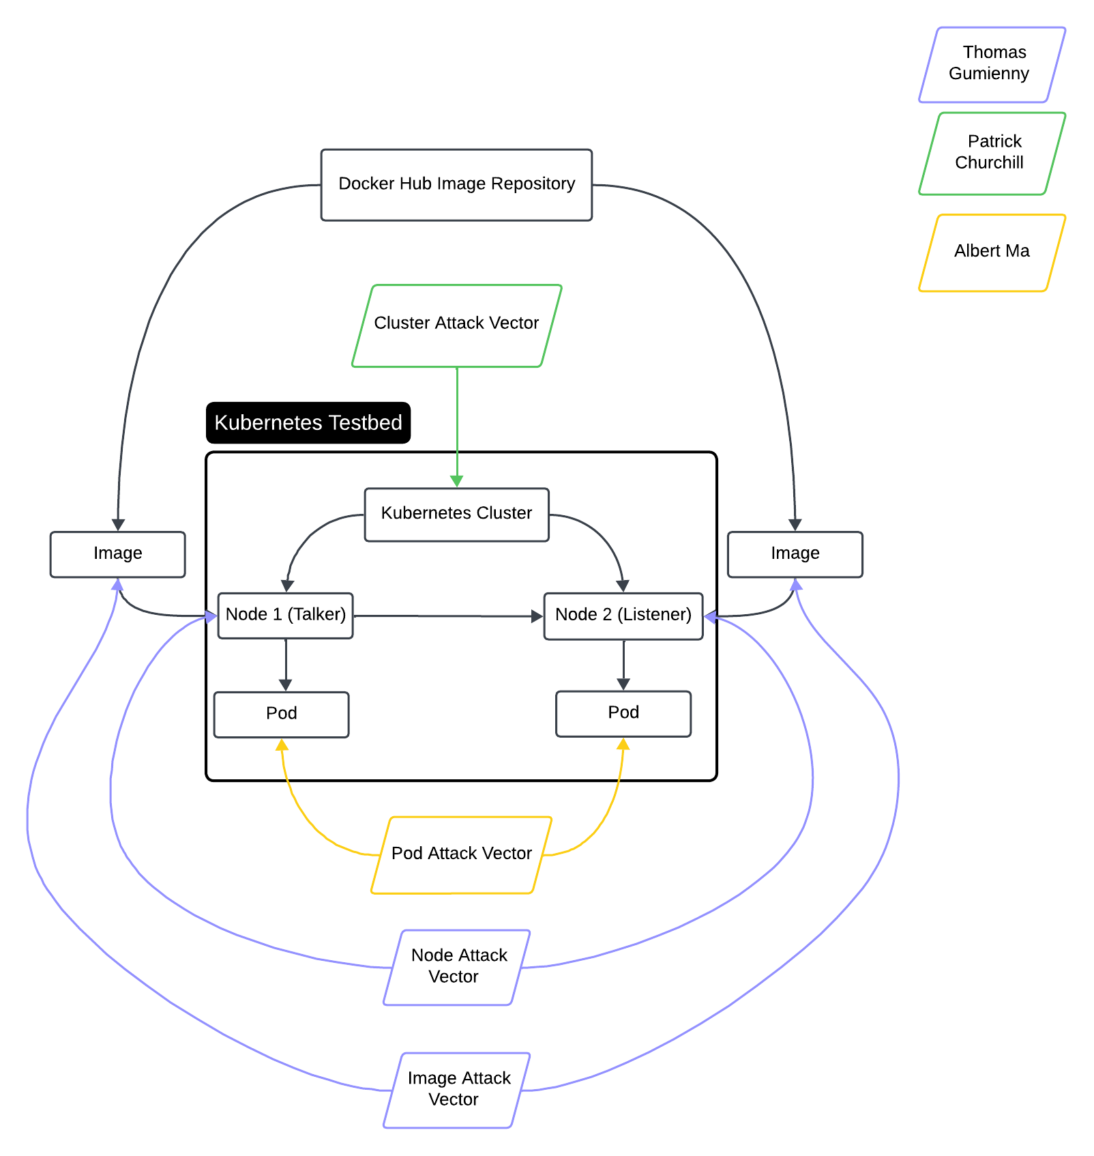
Project/Subsystem Overview
Thomas Gumienny - Image Attack
Image has similar name to normal docker image
When run, image consumes CPU/GPU resources
Albert Ma - Pod Attack
Set up target pod, and conduct reconnaissance on network
Gain access to target pod and container and all stored info
Patrick Churchill - Cluster Attack
Server Node applies pods upon Agent Node that overload the memory and CPU on Server Node, causing it to crash
Notes:
Eric

Slide 4
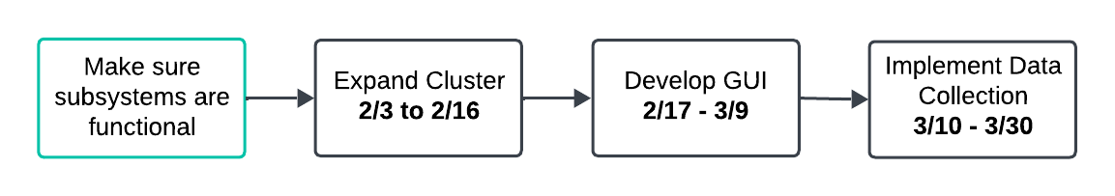
Project Timeline
Notes:
Eric

Slide 5
Image Attack Vector
Thomas Gumienny
Accomplishments since 1/22 11 hrs of effort | Ongoing progress/problems and plans until the next presentation
Kubeshark now able to export pcap files Camera live feed implemented as docker image | Run docker image in Kubernetes pod so it registers on the cluster and Kubeshark Make attack executable script

Slide 6
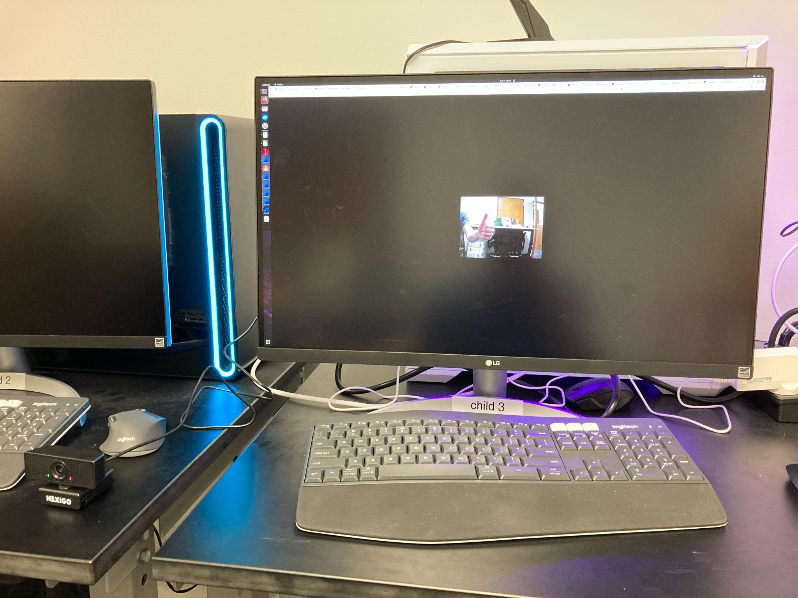
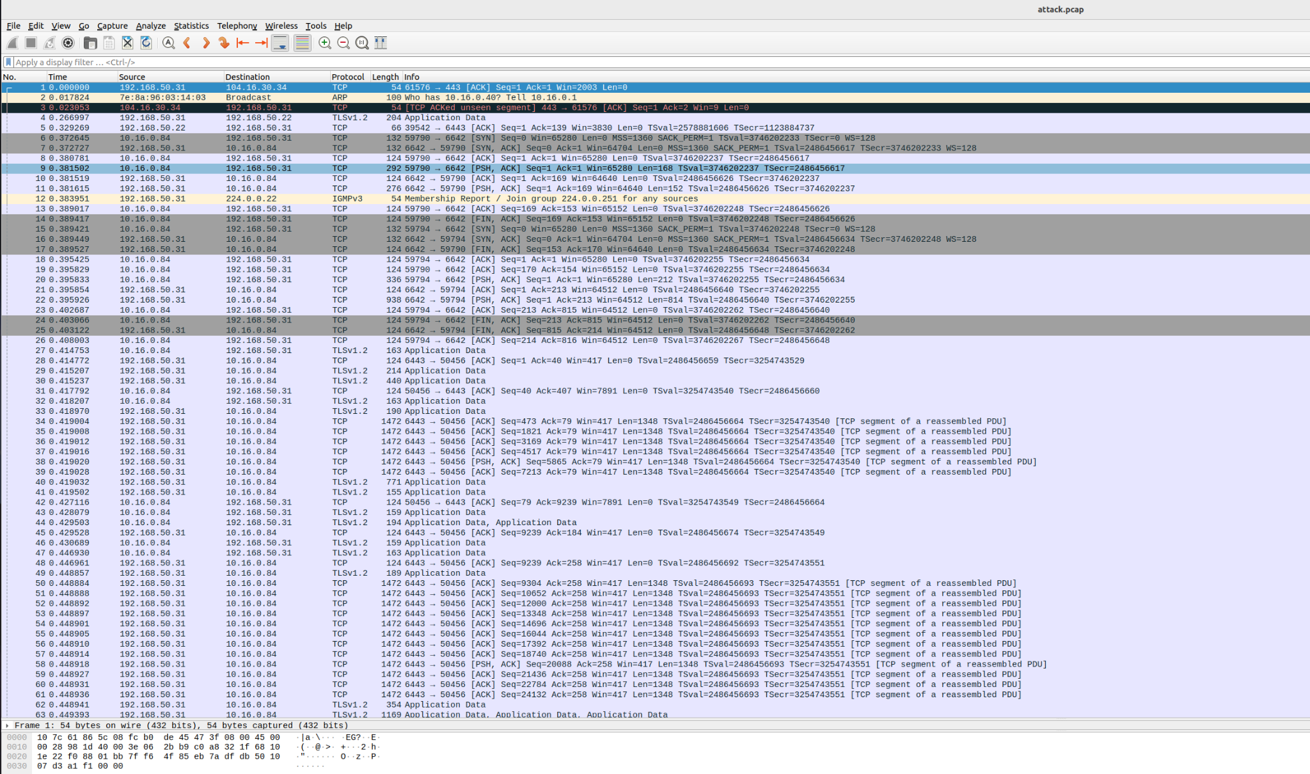
Image Attack Vector
Thomas Gumienny

Slide 7
Node Attack Vector
Patrick Churchill
Accomplishments since 1/22 12 hrs of effort | Ongoing progress/problems and plans until the next presentation
Developed softshell GUI Increased measuring tools for attack | Adding our specific attacks to GUI Pulling data from applications

Slide 8
Pod Attack Vector
Albert Ma
Accomplishments since 1/22 12 hrs of effort | Ongoing progress/problems and plans until the next presentation
localhost-api connectivity issue has been debugged, now configures target and attack container, accesses information in target container/pod’s environment variables (same place as end of 403, albeit with sudo access) | Developing a script that can extract the information it can access (to be added to GUI) Make the extracted info to usable data

Slide 9
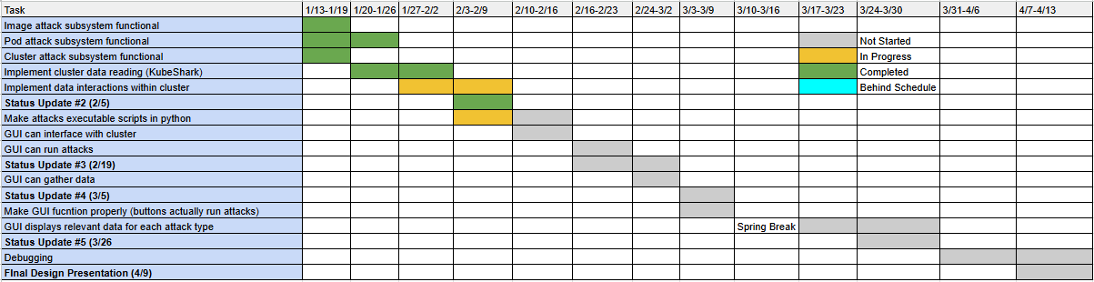
Execution Plan
Notes:
Michelle

Slide 10
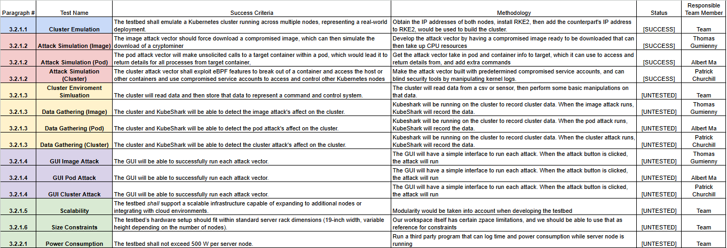
Validation Pan
Notes:
Michelle

Slide 11
Thank You

